Slide 1
Advertising, Public Relations, Promotions, Direct Marketing, and Personal Selling
Chapter Eleven

Slide 2
Chapter Objectives
Tell what advertising is, describe the major types of advertising, and discuss some of the criticisms of advertising
Describe the process of developing an advertising campaign and how marketers evaluate advertising
Explain the role of public relations and the steps in developing a public relations campaign
Explain what sales promotion is, and describe the different types of consumer sales promotions activities
Identify the sales promotion elements that are aimed at other channel members rather than at consumers
Understand the elements of direct marketing
Understand the important role of personal selling and how it fits into the promotion mix
Copyright © 2013 Pearson Canada Inc.
11-<number>
Notes:
p. 388

Slide 3
I. Tell what advertising is, describe the major types of advertising, and discuss some of the criticisms of advertising
Copyright © 2013 Pearson Canada Inc.
11-<number>
Notes:
This slide relates to Learning Objective (hereafter LO) #1 of chapter 11.

Slide 4
Advertising:
The Image of Marketing
Traditional advertising is still very important
Marketers are diverting more money into alternative media
Advertising is the best way to reach mass audiences
Copyright © 2013 Pearson Canada Inc.
11-<number>
Notes:
This slide relates to LO #1 of chapter 11.
p. 388
LECTURE NOTES:
While many people feel that advertising and marketing are the same thing, we know better. Advertising is just one element of the Promotion aspect of the 4 “P’s”.
The economic crisis took it’s toll on the marketing industry in 2009 as over 58,000 jobs were lost due to the downturn in business. In 2009 US marketers spent just over $125 billion on advertising, which had declined more than 12 percent from the previous year.
In January of 2011, Kantar Media reported that US ad expenditures increased 6.4% during the first nine months of 2010, indicating that the recovery in ad spending continues. Surprisingly, spot TV expenditures experienced the largest gains as expenditures increased by nearly 28% due to increased investment by retailers, car manufacturers, and political candidates. Internet display advertising grew by 7.7 percent, and outdoor also increased substantially (7.3%). Still, local newspaper ad expenditures fell 4.4%. In fact, the decline in local newspaper spending marks the continuation of a five year trend as spending on newspaper advertising has now declined for 20 consecutive quarters. {SOURCE: http://kantarmediana.com/intelligence/press/us-advertising-expenditures-increased-64-percent-q3-2010}
These numbers support the fact that advertising is still the best way to reach mass audiences. However, despite the apparent growth of ad spending reported by Kantar, it must be remembered that this growth is more in line with a spending increase due to a recovery by the economy more so than anything else. Actually, many advertising dollars formally spent on traditional media are now being diverted to social media, search engine advertising, and buzz creation efforts, none of which are tracked by Kantar.

Slide 5
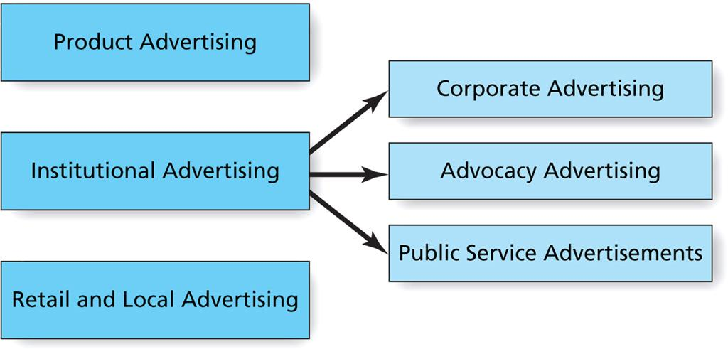
Figure 11.1
Types of Advertising
Copyright © 2013 Pearson Canada Inc.
11-<number>
Notes:
This slide relates to LO #1 of chapter 11.
p. 389
LECTURE NOTES:
Figure 11.1 shows the different forms that advertisements can take.
Product advertising focuses on a specific good or service and constitutes the bulk of most advertising. This includes brand image advertising, as well as those ads that seek to create awareness of new brands or brand features and benefits, or remind consumers about an existing brand.
Institutional advertising promotes the activities, personality, or point of view of an organization or company and includes three subtypes.
Corporate advertising seeks to promote the company as a whole, rather than any one specific brand. Very often corporate ads seek to create goodwill toward the firm, or improve its overall image. British Petroleum engaged in a great deal of corporate advertising following the malfunction of a deepwater oil drill in 2010 that resulted in an enormous amount of oil being poured into the Gulf for several months.
Advocacy advertising is a type of public service advertising where the firm actually tries to influence public opinion on some issue because it has a stake in the outcome.
Public service announcements (PSA) are run for free by the media because the ads support not-for-profit organizations, or because they champion a cause or change for the greater societal good.
Retail and local advertising is simply the designation used to describe ads run by both major retailers and small businesses within a given geographic market.

Slide 6
Who Creates Advertising?
Advertising campaign
    A coordinated, comprehensive plan that carries out promotion objectives and results in a series of advertisements placed in media over a period of time
Outside agencies are often retained to oversee campaigns
  Limited-service agency
  Full-service agency
Copyright © 2013 Pearson Canada Inc.
11-<number>
Notes:
This slide relates to LO #1 of chapter 11.
p. 390
LECTURE NOTES:
Advertising campaigns may be based around a single idea or ad, though more often multiple messages are used within a campaign.
While some manufacturers or retailers create their own advertising, it is becoming more common for creative services such as advertising to be outsourced in some capacity.
Limited-service agencies provide one or more specialized services, such as creative development, media buying, search engine marketing, etc.
Full-service agencies provide almost all of the services needed to mount a campaign, including research, creation of the ad copy and visuals, media selection and placement, and production of the final messages.
DISCUSSION NOTE:
It might be worthwhile to return to www.adcouncil.org, select the CAMPAIGNS subpage, then choose a particular campaign to explore. Once a particular campaign button is selected, the various creative executions (TV ads, radio, ads, print ads, outdoor ads, and web banners, etc.) can be accessed from the right hand menus.

Slide 7
Who Creates Advertising? (ctn’d)
Advertising agencies employ specialists who perform a variety of functions
  Account management
  Creative services
  Research and marketing services
  Media planning
Copyright © 2013 Pearson Canada Inc.
11-<number>
Notes:
This slide relates to LO #1 of chapter 11.
p. 391
LECTURE NOTES:
A range of specialists are needed to put together an advertising campaign.
Account management services are provided the account executive (or manager) who oversees the day-to-day activities and decisions related to the campaign. This individual also acts as the liaison between the agency and the client. The account planner acts as the voice of the consumer by using research results to develop the strategy for an effective campaign.
Creative services are provided by copywriters, art directors, and the creative director who actually implement the ad strategy and create the ad executions.
Research and marketing services are provided by those who collect and analyze information. They also assist with advertising pretesting.
Media planning is carried by the media planner who determines which media vehicles will carry the marketing communication messages.

Slide 8
User-Generated Advertising Content:
Do-it-Yourself Advertising and Crowdsourcing
User-generated content (UGC) or consumer-generated media (CGM)
    Online consumer comments, opinions, advice and discussions, reviews, photos, images, videos, podcasts, webcasts, and product related stories available to other consumers
  Marketers encourage do-it-yourself ads
  Crowdsourcing is used to solicit ideas from consumers
Copyright © 2013 Pearson Canada Inc.
11-<number>
Notes:
This slide relates to LO #2 of chapter 11.
p. 391 - 392
LECTURE NOTES:
User-generated content (UGC) or consumer-generated media (CGM) is it is sometimes called is becoming more common. While this can include all of the activities incorporated in the definition, it also includes ads created by consumers in response to contests such as the “Crash the Super Bowl” Doritos contest.
UGC should be monitored and encouraged by marketers.
Because it stems from consumers, the information is generally considered to be more trustworthy.
As discussed previously, the Internet and the various forms of user-generated content are key sources of information for many consumers.
Do-it-yourself (DIY) ads are less costly, often costing only ¼ as much than those produced by agencies. This makes DIY ads more attractive for smaller businesses and emerging brands. Another benefit from stems from the chance to gather more creative ideas, especially those that provide useful feedback on how consumers see the brand.
Crowdsourcing taps into online communities that are fans of a particular brand or product. These individuals might be asked to contribute ideas for advertising, logos, package designs, etc., or simply asked to “vote” on potential designs or executions. For example, Toyota and Nascar have jointly sponsored multiple contests that challenge Nascar fans to design their own car, complete with sponsor logos. Once a number of designs have been submitted, fans vote for their favorite design, and the winning design is implemented and run in a Nascar race.
While ideally marketers would like consumers to participate in crowdsourcing activities for free, activities focusing on advertising creation have increasingly begun to offer monetary rewards.

Slide 9
Ethical Issues in Advertising
Ethical criticisms of advertising
  Advertising is manipulative
  Advertising is deceptive and untruthful
  Advertising is offensive and in bad taste
  Advertising creates and perpetuates stereotypes
  Advertising causes people to buy things that they don’t really need
Copyright © 2013 Pearson Canada Inc.
11-<number>
Notes:
This slide relates to LO #1 of chapter 11.
p. 392 - 393
LECTURE NOTES:
Ethical criticisms of advertising have existed for some time, and include the following:
Advertising is manipulative: this criticism implies that consumers lack the free will to resist advertising efforts and thus make purchases that they otherwise would not have made. Advertising does try to persuade, but that is a far cry from manipulating people.
Advertising is deceptive and untruthful: In general, this criticism is false, but only because notable past abuses have forced the Federal Trade Commission to regulate advertising. In fact, the FTC can order corrective advertising to clarify previously made deceptive claims if circumstances warrant it. Still, this criticism persists, perhaps because puffery is legally allowable in advertising. Puffed claims are those that make vague claims of superiority that aren’t linked to any specific feature or benefit, which any reasonable consumer would discount. “World’s Best” would be one example. Greenwashing is another reason why consumers continue to believe that advertising is deceptive or untruthful. Greenwashing occurs when companies promote their products as being environmentally friendly when in fact the brand provides few or no ecological benefits.
Advertising is offensive and in bad taste: The problem with this criticism is that tastes differ, and what may be seen as offensive or in bad taste by one individual may in fact be seen as perfectly fine by another individual. In fact, one of the dangers in using humor as a creative strategy is that what’s considered funny by one group of people may be considered offensive by another. This is particularly true when attempting to use humor in international marketing efforts.
Advertising creates and perpetuates stereotypes: While there used to be some truth to this criticism, marketers have made great strides towards eliminating some of the more common stereotypes such as portraying women as homemakers, and African-Americans as holding only lower-end jobs. Yet certain stereotypes persist, both in advertising, and our culture. In that sense, advertising doesn’t so much create stereotypes as it does reflect them.
Advertising causes people to buy things that they don’t really need: This criticism is difficult to address as it depends upon an individual’s definition “need”. If usage of this term is restricted to the bare necessities of life of functional aspects of the product, than the criticism is true. However, most consumers strongly desire – want – items beyond the bare necessities, and are often more concerned with the image a purchase portrays than they are the functional benefits provided. In this case, advertising simply makes it possible for consumers to understand their choices before making a decision.

Slide 10
II. Describe the process of developing an advertising campaign and how marketers evaluate advertising
Copyright © 2013 Pearson Canada Inc.
11-<number>
Notes:
This slide relates to LO #2 of chapter 11.

Slide 11
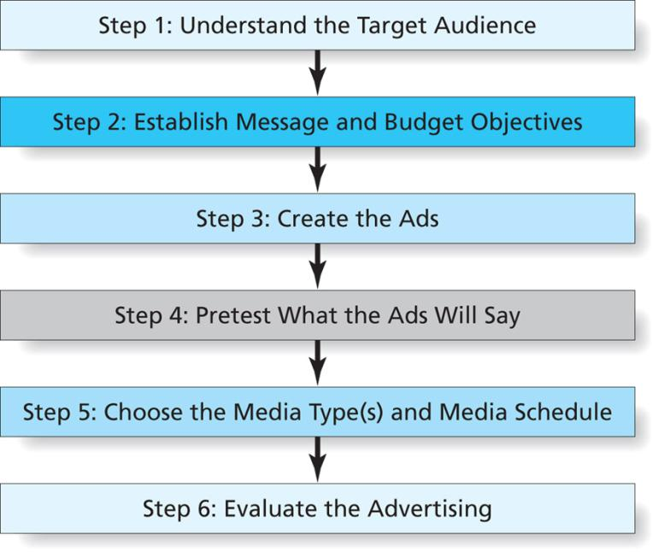
Figure 11.2
Steps to Develop an Advertising Campaign
Copyright © 2013 Pearson Canada Inc.
11-<number>
Notes:
This slide relates to LO #2 of chapter 11.
p. 394
LECTURE NOTES:
Figure 11.2 illustrates the various steps undertaken when developing an advertising campaign.
Identifying the target audience is critical because the best way to communicate with an audience is to understand as much as possible about them in terms of likes and dislikes, language usage, clothing preferences, etc. Sometimes account planners or researchers shadow or hang out with members of the target audience to better understand them; focus groups and survey data can also provide insights.
Establishing the message and budget objectives is the next step. As previously discussed, advertising messages attempt to inform, persuade, or remind consumers of the brand. Budget objectives may dictate that a certain percentage of the overall communication budget be devoted to advertising.

Slide 12
Step 3: Create the Ads
Creative strategy
    The process that turns a concept into an advertisement
Creative brief
    A guideline or blueprint for the marketing communication program that guides the creative process
Four elements are involved in ad creation
    The appeal, the format, the tonality, and the creative tactics and techniques
Copyright © 2013 Pearson Canada Inc.
11-<number>
Notes:
This slide relates to LO #1 of chapter 11.
p. 395 – 396

Slide 13
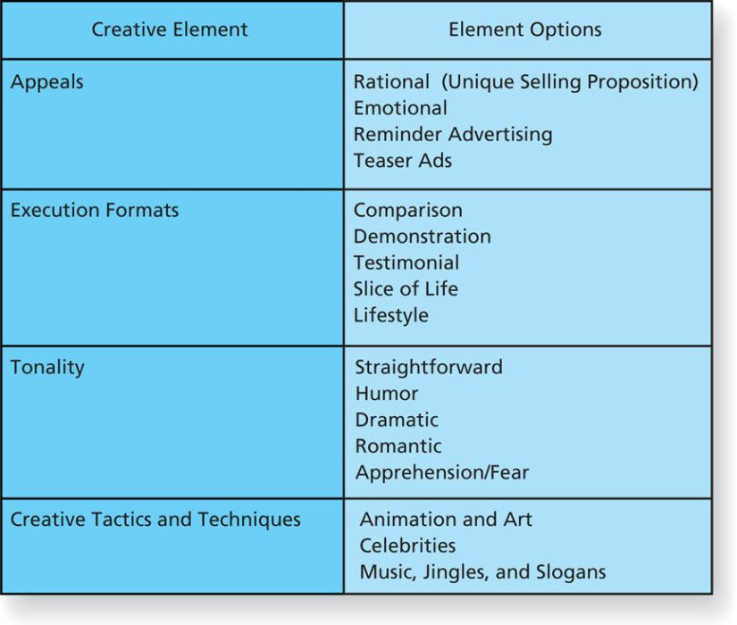
Figure 11.3
Creative Elements of Advertising
Copyright © 2013 Pearson Canada Inc.
11-<number>
Notes:
This slide relates to LO #2 of chapter 11.
p. 396
LECTURE NOTES:
The third step in developing an advertising campaign involves creating the ads. The creative strategy is the process that turns a concept into an advertisement. The strategy is summarized into a written document known as a creative brief which serves as blueprint for the marketing communication program to be developed. Briefs contain relevant information and insights, the campaign objectives, and information on the competition, target market, and message that is to be delivered. The creative brief should provide the spark the agency needs to come up with visual and copy elements of the ads.
To finish the ads, the creative must finalize decisions related to the create appeal, execution format, ad tonality, and other creative tactics and techniques, as shown in Figure 11.3
An advertising appeal is the central idea or theme of the ad. The unique selling proposition (USP) is an example of a rational appeal that relates to consumers’ practical needs for the product. The USP gives consumers a clear, single-minded reason why the advertiser’s product is better than the competition. Of course not all products are bought on the basis of rational considerations. Therefore, emotional appeals, such as love, safety, fear, pleasure, ext. are often used to market products that are bought on the basis of social or psychological needs. Reminder ads don’t really fit into either of these categories, as the primary purpose is simply to keep the brand name in consumer’s mind. Finally, teaser ads are often used to generated curiosity about a soon-to-be-introduced new product.

Slide 14
BAB235 CH11 - In class Group Activity 2
Go online and find a product adverts that fits each of the following categories:
a. USP strategy
b. Demonstration
c. Testimonial
d. Slice-of-life
e. Humor-oriented
Required:
Critique each ad.
Tell who the target market appears to be.
Describe how the message is executed.
Discuss what is good and bad about the ad.
Do you think the ad will be effective?
Why or why not?
Copyright © 2013 Pearson Canada Inc.
13-<number>

Slide 15
Advertising Appeals
Are the central idea or theme of an advertising message
  Informational or rational appeals
    Relate to consumers’ practical need for the product
    Often based on unique selling proposition (USP)
  Emotional appeals
    Focus on emotional or social benefits associated with the product
  Reminder advertising
  Teaser or mystery advertising
Copyright © 2013 Pearson Canada Inc.
11-<number>
Notes:
This slide relates to LO #2 of chapter 11.
p. 396 – 397

Slide 16
Execution Formats
Refer to the basic structure of the message such as
  Comparison-Finish and Cascade advert
  Demonstration- Swiffer advert
  Testimonial-Angelina Joli-Louis Vuitton
  Slice of life- Buckley's
  Lifestyle-Redbull
Copyright © 2013 Pearson Canada Inc.
11-<number>
Notes:
This slide relates to LO #2 of chapter 11.
p. 397
LECTURE NOTES:
Execution formats such comparison, demonstration, testimonial, slice of life, or lifestyle can be used individually or in combination within an advertising campaign.
Comparison ads typically name one or more competitors directly, and can be very effective. However, negative comparative ads which attack the competition (such as are commonly used in politics) turn-off consumers and may backfire. Negative comparative ads in product advertising is rare for this reason. Comparison ads work best for market share challengers, particularly when they enjoy a competitive advantage. Market leaders rarely use comparative advertising because consumers often perceive such tactics as picking on the little guy.
As the name suggests, demonstration ads show the product in use. This format is best used when consumers are unable to identify benefits except when the see the product in action.
Testimonial ads typically feature either celebrities or typical person, “man-on-the-street” endorsers. The use of celebrities can increase the cost of the ad campaign substantially.
Slice of life formats focus on everyday life scenes in which the product plays a role., and help to convince the consumer that “real” people use the brand.
Finally, the lifestyle format shows people enjoying a lifestyle or activity while consuming or using the brand. Such ads often imply that buying the product will help consumers attain the lifestyle in question.

Slide 17
Tonality
Refer to the mood or attitude the message conveys
  Straightforward
  Humor
  Dramatic
  Romantic
  Sexy
  Apprehension/fear
Copyright © 2013 Pearson Canada Inc.
11-<number>
Notes:
This slide relates to LO #2 of chapter 11.
p. 397 – 398

Slide 18
Creative Tactics and Techniques
Some of the creative tactics and techniques are
  Animation and art-Scooby-Do: Graham Crackers, SpongeBob-Grimmway carrot
  Celebrities-Jessica Simpson -Proactive
  Music, jingles, and slogans-Cashman Oliver.
Copyright © 2013 Pearson Canada Inc.
11-<number>
Notes:
This slide relates to LO #2 of chapter 11.
p. 398 – 399
LECTURE NOTES:
Sometimes the creative process will include animation and art, celebrities, and/or music, jingles, and slogans.
Animation and art can be appropriate when ad features a licensed cartoon character, such as Bart Simpson, when illustrating a visual is more cost effective or visually desirable than photographing the concept, or when one of these techniques is used to help achieve a certain look or reach a particular type of consumer (e.g., animation will attract children).
Celebrities such as Britney Spear’s may simply appear in ads, such as the Candie’s ad, or they may be shown actively promoting or endorsing a product or service.
Jingles are original words and music written specifically for ad execution, whereas slogans are simple memorable linguistic devices linked to a brand. The popularity of jingles has been declining. Both jingles and slogans are powerful memory aids; consumers can often remember slogans or sing jingles years after the original campaign has ended.

Slide 19

Step 4: Pretest What the Ads Will Say
Pretesting
    Research method that seeks to minimize mistakes by getting consumer reactions to ad messages before they appear in the media
Eye Tracking Example
Copyright © 2013 Pearson Canada Inc.
11-<number>
Notes:
This slide relates to LO #2 of chapter 11.
p. 399
LECTURE NOTES:
The creative process is expensive, but launching an advertising campaign and paying media costs is even more so. To minimize costly mistakes, pretesting of advertising executions is fairly common. Focus groups may be used early on in the process, and surveys that analyze attitudes towards ads, brands, and purchase intentions may be used as well.
Some researchers use eye tracking technology to gauge whether the consumer is focusing on the desired ad elements, and lately, MRI imaging of the brain has been used to assess consumers’ emotional reactions to ads.
WEBSITE NOTE:
The eye tracking example links to a video on YouTube. The video provides a thorough overview of how this technique works and requires 3:25 to view.

Slide 20
Step 5: Choose the Media Type(s) and Media Schedule
Media planning
    The process of developing media objectives, strategies, and tactics
  Determine the following with respect to ad messages
    Where to say it
    When to say it
    How often to say it
Copyright © 2013 Pearson Canada Inc.
11-<number>
Notes:
This slide relates to LO #2 of chapter 11.
p. 399 – 409
LECTURE NOTES:
Media planners begin the planning process by discovering where and when members of the target market are most likely to be exposed to marketing communication messages.
No single medium is perfect for all advertising situations. It is critical that the selection of media categories, such as TV, and media vehicles, such as Monday Night Football, be matched to the target market profile and fall within budget constraints.
Media mix choices are complicated by the wide variety of new options, including mobile advertising, video game advertising, and others. However, we’ll begin our discussion with an analysis of traditional mass media.

Slide 21
Where To Say It: Traditional Mass Media
Each of the traditional media has pros and cons
  Television
  Radio
  Newspapers
  Magazines
Copyright © 2013 Pearson Canada Inc.
11-<number>
Notes:
This slide relates to LO #2 of chapter 11.
p. 400 – 403
LECTURE NOTES:
Table 11.1 does an excellent job of summarizing the various pros and cons of media vehicles, including traditional media. We’ll discuss some of the key pros and cons listed in the table.
Television: Featuring sound, motion, and video, TV is one of the most creative mediums available to advertisers. The wide reach of TV makes it an excellent choice for national advertisers. However, advertising on TV – especially at the national level – is NOT cheap. The cost to place a single 30 second ad nationally runs $200,000 and up. TV viewing patterns have changed over time; while broadcast TV has declined in viewership, cable and satellite viewership has grown. Still, some viewers are abandoning TV altogether in favor of watching shows on Hulu.com or other Internet sites, and many advertisers have noted that the effectiveness of advertising is in decline, particularly due to the growth of DVRs and video-on-demand. Finally, ad scheduling has been made more difficult by the proliferation of cable channels which has fractionalized the TV viewing audience.
Radio is an excellent medium for local advertisers, and one that is available just about anywhere – at home, work, and in the car. However, radio often fades into the background and many people don’t pay attention to radio ad. Still, radio is very flexible. Low costs per ad and short lead time make it easy for marketers to respond to changes in the marketplaces, and the lack of visuals actually allows marketers to describe situations that stimulate the imagination. However this also means that radio is not appropriate for products that must be demonstrated or seen to be appreciated. Furthermore, buying radio for a national campaign is extremely difficult.
Newspapers tend to be localized, the Wall Street Journal and USA Today are two notable exceptions. Newspaper readership is in decline, and ads have a short life span. However, many newspapers are launching web sites to try and recapture some of their lost readership. Newspaper ads often compete with one another in a very cluttered environment and the reproduction quality is somewhat poor. Though most newspapers do offer color as a creative option. On the bright side, newspapers over a short time between placing an ad and running it, flexibility in terms of ad sizes, and readers are often in the right mental frame of mind to process the ad. Plus, detailed copy can be presented. However, newspapers do not offer a very efficient way to reach a specific target market so many ad exposures are wasted on people who have no need for the item in question.
Magazines offer marketers an excellent method of targeting individuals who enjoy a particular lifestyle, or who are of a certain age or race. This makes magazine advertising more efficient than newspapers in terms of reaching a specific target market. Magazines provide excellent ad reproduction quality via glossy, colored full-page ads, and have high credibility. Unlike newspapers which are read and discarded, magazines have a long life and are often passed along to other readers. Detailed product information can be conveyed. Unfortunately, the cost of a typical 4-color ad in a general interest magazine easily exceeds $100,000. Magazine ads also must be submitted well in advance of the stated issue date, and the large number of ads in magazines create a great deal of clutter. Finally, the specialized nature of magazines means that advertisers often must use multiplied magazines to reach the entire target market.

Slide 22
Where To Say It: Digital Media
Digital media takes many forms
  Owned, paid, and earned media
  Web site advertising
    Banners
    Pop-up ads
    Buttons
    Search engines and web directory
    E-mail advertising
  Mobile advertising
  Video sharing
Copyright © 2013 Pearson Canada Inc.
11-<number>
Notes:
This slide relates to LO #2 of chapter 11.
p. 403 – 405
LECTURE NOTES:
Digital media refers to any media that are digital rather than analog. A list of potential digital media appears on this slide, and the relative pros and cons of website advertising are listed in Table 11.1
Owned media include websites, blogs, Facebook and Twitter accounts that are owned by the advertiser, while paid media includes options such as search engine marketing, internet display ads, and site sponsorships which are paid for by advertisers. Earned media refers to WOM or buzz that occurs as a result of social media over which the advertiser has no control.
More and more brands are being promoted online via websites or on display ads posted to websites. These forms of digital media offer exceptional targeting capabilities, as well as the means by which to track user preferences and behaviors. Ads or offers can be targeted based on these user profiles, and tracking ad effectiveness is as easy as counting the number of impressions (the number of times the ad is shown) and the number of clicks.
Most of you should be familiar with the different forms of digital media listed on the page. Banner ads appear at the top of a web page while buttons are smaller ads that can be placed anywhere on a web page. Pop-ads are the most intrusive form of ad as they appear on top of content that the reader is viewing. Many software programs block pop-up ads as a matter of course.
Search engines such as Google! allow consumers to search for websites on the basis of keywords. Marketers have the option of purchasing Sponsored links when certain key words are typed in. However, the regular results returned by a search or the “natural” results are free. Web directories list sites by categories and subcategories.
You’re certainly familiar by now with email advertising. Unfortunately, the vast amount of unsolicited email advertising, or SPAM, has given this technique a bit of a bad name. Ethical marketers use a permission based strategy in which recipients must be explicitly agree to receive email before being added to the list.
Mobile advertising is communicated to the consumer via a handset such as a smartphone. Many marketers are now offering mobile websites, mobile messaging and of course, mobile apps. The inclusion of GPS components in many hand-held devices has helped to stimulate the growth of location-based advertising in which targeted messages are sent to opt-in users based on their location.
Video sharing by marketers is prominent on YouTube and other sites that allow for the uploading of video recordings. In addition to uploading videos of ads, or demonstrations of services for B2B marketers, many firms use video sharing to build relationships with customers. For example, Home Depot provides free do-it-yourself videos.

Slide 23
Where To Say It: Branded Entertainment
Branded entertainment
    A form of advertising in which marketers integrate products into entertainment venues
  Product placements
  Advergaming
Copyright © 2013 Pearson Canada Inc.
11-<number>
Notes:
This slide relates to LO #2 of chapter 11.
p. 405 – 406
LECTURE NOTES:
Product placements in movies and TV shows are one example of branded entertainment. The advantage is that this form of advertising may be more successful at grabbing the attention of consumers who otherwise tune out traditional advertising. The idea is that consumers develop a more favorable attitude toward a brand that is being used by a celebrity in the course of a movie or television show.
Another form of branded entertainment occurs when an advertiser actively develops new TV programs to showcase their products. TNT and Dodge got together to product Lucky Chance, a miniseries about the DEA that essentially promoted the Dodge Challenger (which was driven by a key character).
Advergaming is also growing in popularity. Real-life brands are embedded in the video game action and thus subtly create awareness for the brands.

Slide 24
Where To Say It: Support Media
Support media reaches people who are not reached by mass media advertising
  Directories
  Out-of-home media
  Place-based media: message in airport, restrooms, public places
  RFID technology(radio frequency identification)
Renault’s use of RFID
Copyright © 2013 Pearson Canada Inc.
11-<number>
Notes:
This slide relates to LO #2 of chapter 11.
p. 406 – 407
LECTURE NOTES:
Support media rarely can be relied upon for the entire marketing campaign, but are often an essential part of an integrated marketing communications strategy.
The Yellow Pages (and similar directories) is(are) popular advertising choices for many small business people who operate in limited geographic markets.
Out-of-home media includes billboards, transit ads, and other ads that reach people in public places. Digital signage is a recent trend that allows messages to change at will.
Place-based media includes messages such as those found in airports, physician offices, restrooms, and other public locations. They also include place-based video screens which can be found in stores, health clubs, and other locations across the U.S.
RFID technology uses tiny sensors embedded in the packaging of merchandise or the store aisles themselves to track customers as they pass by in a manner similar to that featured in the sci-fi movie, Minority Report. The sensors could launch a short video ad on a monitor in response to an RFID tag, or potentially become more invasive if linked to a consumer’s personal information or shopping history.
Renault used RFID technology in an even more innovative manner. Let’s watch a short one minute video that explains how.

Slide 25
When to Say it: Media Scheduling
Media schedule
    The plan that specifies the exact medium to use and when to use them
Quantitative factors to consider when develop the media schedule
  Reach
  Frequency
  Gross rating points (GRPs)
  Cost and cost per thousand (CPM)
Copyright © 2013 Pearson Canada Inc.
11-<number>
Notes:
This slide relates to LO #2 of chapter 11.
p. 407 - 409

Slide 26
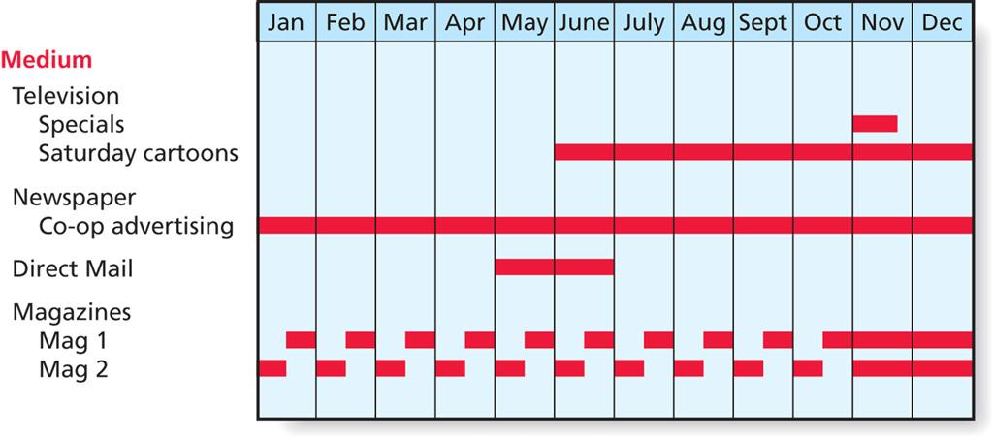
Figure 11.4
Media Schedule for a Video Game
Copyright © 2013 Pearson Canada Inc.
11-<number>
Notes:
This slide relates to LO #2 of chapter 11.
p. 407
LECTURE NOTES:
The media schedule specifies the exact media categories to be used and charts out when it will be used. The sample media schedule shown in Figure 11.4 provides a visual illustration of an advertiser’s efforts over the course of the campaign.
In selecting the media for the campaign, the planner considers qualitative factors such as the match between a media vehicle and the profile of the target market, as well as how competitors advertise, and the ability of the medium to convey information.
Quantitative factors used in media scheduling include reach, which is the percentage of the target market that will be exposed to the media vehicle; frequency, or the average number of times a member of the target group will see the ad; gross rating points, which is simply the product of reach (expressed as a whole number) times frequency, and CPM, or the cost to reach 1,000 people or homes, which can be used to compare the relative cost-effectiveness of different vehicles within a media category.

Slide 27
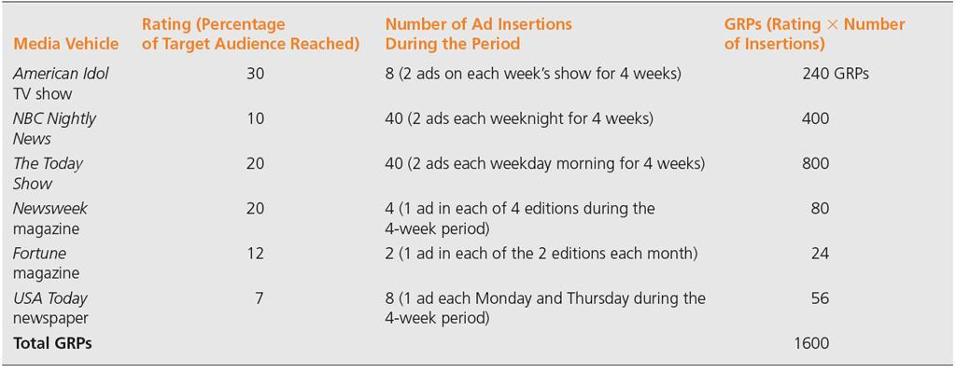
Table 11.2
A (Hypothetical) Media Schedule
Copyright © 2013 Pearson Canada Inc.
11-<number>
Notes:
This slide relates to LO #2 of chapter 11.
p. 408
LECTURE NOTES:
Table 11.2 illustrates how GRPs are calculated and summed to develop an estimate of the total number of GRPs a proposed campaign is likely to generate. Of course this relies on ESTIMATES of reach or ratings provided by syndicated research firms such as Nielsen (for TV), Arbitron (for Radio), and other sources for print circulation.

Slide 28
Media Scheduling: How Often To Say It
Continuous schedule
    Maintains a steady stream of advertising throughout the year
    Wear-out may be a problem
Pulsing schedule
    Varies the amount of advertising throughout the year, based on when the product is likely to be in demand
Flighting schedule
    Advertising appears in short, intense bursts alternating with periods of little to no activity
Copyright © 2013 Pearson Canada Inc.
11-<number>
Notes:
This slide relates to LO #2 of chapter 11.
p. 408
LECTURE NOTES:
The decision of how often to advertise is an important part of media planning. Typical advertising patterns, or the continuity of advertising as it is often called include:
Continuous schedules in which a steady stream of advertising is used throughout the year. This strategy can lead to wear-out, meaning that ads become less effective as people tune out the same old message. To combat this, long-running campaigns such as the “Got Milk” campaign varies its ad executions, in this case by changing celebrities on a regular basis.
Pulsing schedules vary the amount of advertising based on when the product is likely to be demanded, and thus are highly appropriate for products that are sold year-round but which enjoy higher sales at certain times of the year.
Flighting schedules are used when advertising is undertaken in short, intense bursts, alternated with periods in which no
advertising is done at all. Flighting is often an acceptable alternative to a continuous strategy because when executed properly, it is capable of creating as much brand awareness for a lower cost, assuming consumers noticed the ads from the previous “flight” and these ads made an impact.

Slide 29
Step 6: Evaluate the Advertising
Posttesting
    Research on consumers’ responses to advertising messages they have seen or heard
  Unaided recall
  Aided recall
  Attitudinal measures
Copyright © 2013 Pearson Canada Inc.
11-<number>
Notes:
This slide relates to LO #2 of chapter 11.
p. 409 - 410
LECTURE NOTES:
Earlier we talked about the need for pretesting of advertising in order to avoid costly mistakes. Unfortunately, despite this pretesting, much of advertising remains ineffective. Many marketers therefore choose to conduct advertising posttests to confirm whether or not the ads accomplished their communication goals. The three methods of measuring an ad’s impact include aided and unaided recall, and various attitudinal measures.
Unaided recall tests conducted by phone or personal interview asks whether a person remembers seeing an ad during a specified period of time without specifically naming the brand.
Aided recall tests use clues to prompt answers from people about ads that they may have seen. The clue might include the script or storyboard of a TV commercial (with the brand name or other identifying features such as the package design left off) or a list of brand names from which consumers .
Attitudinal measures probe a consumer’s beliefs, or feelings about a product before and after consumer are exposed to the ad. Common attitudinal measures include attitudes toward the ad, the brand, specific copy points within the ad, or purchase intentions towards the product.

Slide 30
III. Explain the role of public relations and the steps in developing a public relations campaign
Copyright © 2013 Pearson Canada Inc.
11-<number>
Notes:
This slide relates to LO #3 of chapter 11.

Slide 31
Public Relations
Public relations (PR)
    Communication function that seeks to build good relationships with an organization’s publics, including consumers, stockholders, legislators, and other stakeholders
PR is crucial to establish and maintain a favourable image
  Publicity
PR is critical when a firm’s image is at risk due to negative publicity
  Crisis management
Copyright © 2013 Pearson Canada Inc.
11-<number>
Notes:
This slide relates to LO #3 of chapter 11.
p. 410 - 411
LECTURE NOTES:
Public relations efforts generally target more than just consumers. Annual reports convey important information to stockholders and investment analysts, and other communication efforts may target members of the legislature or other stakeholders.
From a brand marketing standpoint though, proactive PR efforts confined to publicity are of key importance. Publicity is any form of unpaid communication about an organization that appears in the mass media. Publicity efforts often support other activities such as event marketing, or transcend easy categorization. For example, many people consider buzz building activities to be a specific form of publicity.
One function that is entirely unique to public relations comes in the form of crisis management. Crisis management is defined as the process of managing a firm’s reputation when some negative event threatens the organization’s image. Members of the PR staff work with corporate executives to respond to the crisis and address concerns so neither the public nor supply chain members panic. This may involve initiating product recalls or taking other actions to ensure safety or inform the public of what’s happening. Crisis management may also draw upon corporate advertising or cause-related marketing activities as part of an image recovery strategy. Firms that are well-prepared for disasters are those that have a crisis management plan in place prior to the actual occurrence of a negative event.

Slide 32
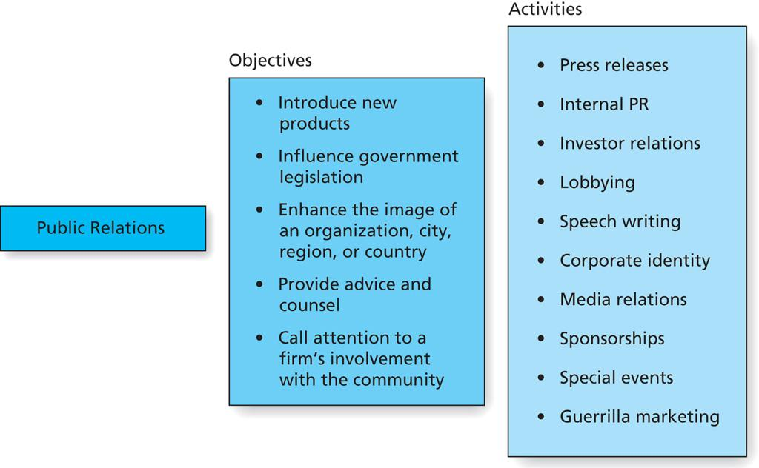
Figure 11.5
Objectives and Tactics of Public Relations
Copyright © 2013 Pearson Canada Inc.
11-<number>
Notes:
This slide relates to LO #3 of chapter 11.
p. 411
LECTURE NOTES:
Planning a public relations campaign is a multi-step process which includes developing clearly defined PR objectives, executing a plan designed to fulfill the objectives, than measuring whether or not the objectives were met.
Figure 11.5 illustrates the variety of PR objectives that a plan might attempt to accomplish, and the various activities which be executed in an attempt to meet the objectives set. Table 11.3 does an excellent job of discussing different methods that can be used to evaluate objectives, and their relative pros and cons. Unfortunately, compared to other marketing communication forms, it has proven difficult to develop metrics to gauge the effectiveness of publicity efforts, so this portion of the campaign process is particularly challenging.

Slide 33
Public Relations Objectives
Typical objectives include
  Introduce new products to retailers and consumers
  Influence government legislation
  Enhance the image of an organization
  Provide advice and counsel
  Enhance the image of a city, region, or country
  Manage a crisis
  Call attention to a firm’s involvement with the community
Copyright © 2013 Pearson Canada Inc.
11-<number>
Notes:
This slide relates to LO #3 of chapter 11.
p. 413 – 414
LECTURE NOTES:
Most of the objectives listed on this slide are self-explanatory. Instead, let’s focus our discussion on the specific PR tools that can be used to accomplish each.
Introducing new products to retailers and consumers often involves the use of press releases, which distribute information to the media and press conferences which invite members of the press to a central location from which they can film a company spokesperson or the CEO making an important announcement.
Influencing government legislation is a specialized task that many firms employ professional lobbyists to perform. Informational videos may also be sent to legislative aids as well as position papers or other informational packets prepared by the public relations staff. The PR staff may also engage in speech writing if a key member of the firm is expected to appear before Congress to make a statement.
Enhancing the image of the firm may involve the use of corporate advertising featuring celebrity endorsers, to the use of social networking and viral marketing efforts. Cause-related marketing events can also help to enhance the image of the firm.
Providing advice and counsel to top management regarding changes in public opinion which might stem from unpopular decisions is one task in which PR staff engage. They provide input on the best way to handle the situation, how to “spin” corporate communications, including press releases, and write speeches as needed for company spokespeople.
Enhancing the image of a city, region, or country makes use of a variety of techniques, including news releases, special events, and much more.
Managing a crisis as previously discussed requires pulling out all the stops. Advising top management, interacting with the media, organizing news conferences, preparing press releases and developing special events, sponsorships, cause-related marketing or corporate advertising to help mitigate the damage may all be used.
Cause-related marketing and sponsorships are tow activities that successfully call attention to a firm’s involvement with the community. Of course news conferences and press releases may occur as part of this process.

Slide 34
Public Relations Tactics
Press releases
  Timely topics
  Research project stories
  Consumer information release
Speech writing and corporate communications
  Speech writing
  Corporate identity
  Media relations
Sponsorships and special events
Guerilla marketing: Marketing strategy which involves ambushing consumers with promotional content in places where they do not expect to encounter these messages.
Copyright © 2013 Pearson Canada Inc.
11-<number>
Notes:
This slide relates to LO #3 of chapter 11.
p. 414 – 416

Slide 35
IV. Explain what sales promotion is, and describe the different types of consumer sales promotions activities
Copyright © 2013 Pearson Canada Inc.
11-<number>
Notes:
This slide relates to LO #4 of chapter 11.

Slide 36
Sales Promotion
Sales promotions
    Programs designed to build interest in or encourage purchase of a product during a specified period of time
  Deliver short-term sales results
  Can target end consumers or channel members
Copyright © 2013 Pearson Canada Inc.
11-<number>
Notes:
This slide relates to LO #4 of chapter 11.
p. 416
LECTURE NOTES:
Sales promotions are appropriate when the marketer is attempting to encourage consumers or members of the distribution channel to take some action relatively quickly. For example, sampling is used to encourage consumers to try the product and hopefully purchase it once they have experienced it. Pay-for-performance incentives encourage retailers to sell more of the manufacturer’s product by providing them with a financial incentive for every unit sold during the promotional period.
Sales promotion budgets have been growing as a proportion of the overall promotional budget for several reasons. Retailers enjoy greater power in their relationships with manufacturer’s and often use this power to force trade deals (sales promotions specific to retailers or wholesalers). Consumers are also becoming less brand loyal and thus are susceptible to switching brands that offer them an incentive to do so.
Sales promotions can target ultimate consumers, members of the manufacturer’s own sales force, retailers or wholesalers.

Slide 37
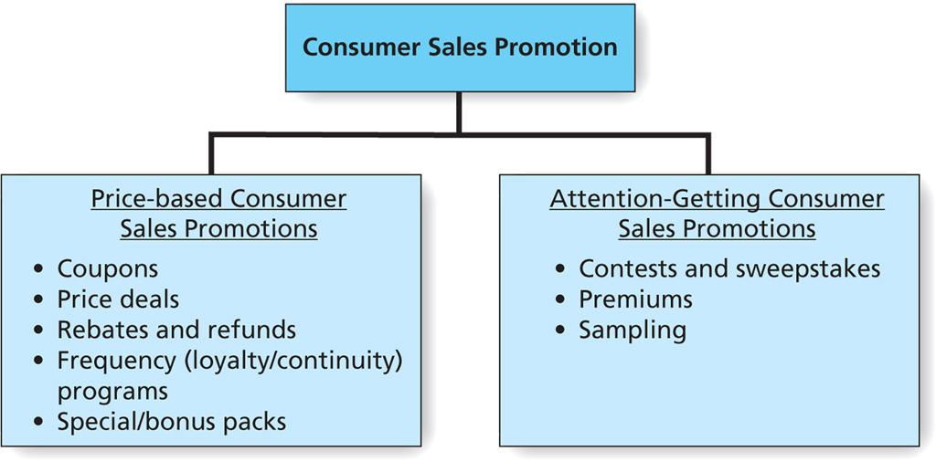
Figure 11.6
Types of Consumer Sales Promotion
Copyright © 2013 Pearson Canada Inc.
11-<number>
Notes:
This slide relates to LO #4 of chapter 11.
p. 418
LECTURE NOTES:
Figure 11.6 organizes the various sales promotion techniques targeted towards consumers as either being price-based or attention-getting techniques. Price-based techniques each share the fact they emphasize some type of short-term price reduction or rebate/refund.
Attention-getting techniques are used to stimulate interest in the product.
Promotional techniques geared toward consumers can also be classified in terms of their primary objective, which may be getting consumers to try the product, holding/rewarding existing product users, or supporting brand image efforts. Sampling is widely acknowledged as the premiere technique for generating consumer trial; instant coupons and scanner-based coupons can also be effective at accomplishing this task. Loyalty programs, in, on, or near pack coupons, bonus packs, price-offs, rebates and many other techniques are typically offered with the intention of either rewarding current customers, or loading consumers (e.g., encouraging stockpiling) so that consumers are immune to the promotional efforts of the competition. Sweepstakes and contests can help to support or maintain a brand image, in addition to their potential to encourage additional sales.
DISCUSSION NOTES:
The instructor may wish to visit the Promo magazine website prior to class (http://promomagazine.com) for a variety of information that could be helpful in teaching this section. The Premiums & Incentives tab and Sweepstakes / Contests tabs will likely contain information about currently running or recently concluded campaigns. Each of these pages also has links to the latest research within the topic area, as well as to archived articles. The White Paper Library may also offer some interesting information. While some information is restricted to subscribers, much can be accessed for free.

Slide 38
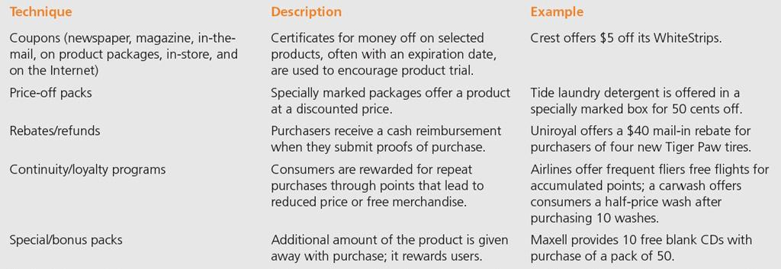
Table 11.4
Consumer Sales Promotion Techniques: A Sampler
Copyright © 2013 Pearson Canada Inc.
11-<number>
Notes:
This slide relates to LO #4 of chapter 11.
p. 417
LECTURE NOTES:
Let’s begin by discussing price-based promotions in more detail.
Coupons are distributed via a number of methods and can be used to either encourage trial of a new product, or to reward and hold current users of the brand. Billions of coupons are distributed annually, making them the most popular form of sales promotion.
Price deals may appear on product packaging or be marked off at the shelf. These price deals provide consumers with an immediate reward for purchasing the brand. Rebates and refunds also discount the price of the item, but consumers pay full price and must send off for the rebate or refund according the specified rules. Redemption rates for rebates and refunds are generally quite low.
Continuity programs are also called frequency or loyalty programs. Essentially these programs provides consumers with a reward of some type after a certain number of purchases have been made. For example, after purchasing 10 car washes from the same service provider, a consumer may receive the next one for free. Another variation allows consumers to collect points which can then be applied toward the acquisition of free goods. Many branded Visa cards work in this fashion.
Bonus packs provide extra quantities of the product without raising the cost of the good. For example, Purina patrons often have the opportunity of buying 55 pounds of dog food for the price normally charged for a 50 lb bag.

Slide 39
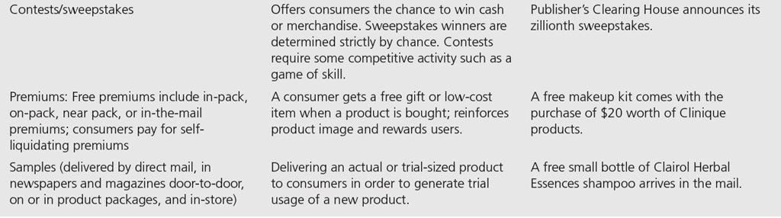
Table 11.4 (ctn’d)
Consumer Sales Promotion Techniques: A Sampler
Copyright © 2013 Pearson Canada Inc.
11-<number>
Notes:
This slide relates to LO #4 of chapter 11.
p. 417
LECTURE NOTES:
Attention-getting consumer promotions basically taken one of three forms.
Contests are based on skill, while sweepstakes are based on chance. Sweepstakes often feature a game component of some type. For example, Coca-cola imprints codes under the caps of its bottled beverages. Consumers enter these codes on the web site to see if they have been randomly selected to win a prize. Ben & Jerry’s launched their “Do Us A Flavor” contest to get consumers to submit the names and descriptions of possible new flavors to their website. Cooking contests tend to be a popular method of letting consumers “strut their stuff” while creating buzz about the firm’s products.
Premiums take a variety of different forms as shown in Table 13.4 but the basic idea is that consumers get something free as a reward for buying the product. The free item might be packaged with the product (for example, a brandy cordial may be packaged with a high-end brandy at Christmas time) or consumers may need to send in proofs of purchase and perhaps a fee to cover the cost of postage in order to receive the premium via mail. Premiums can help to support the brand image when the free item compliments the item purchased, or is branded with the product’s logo or name.
Sampling is the premiere technique for generating new product trial. Samples can be distributed in-store, at events or high-traffic locations, via mail, newspaper, or magazines or over the Internet.

Slide 40
V. Identify the sales promotion elements that are aimed at other channel members rather than at consumers
Copyright © 2013 Pearson Canada Inc.
11-<number>
Notes:
This slide relates to LO #5 of chapter 11.

Slide 41
Sales Promotions Directed toward the Trade
Trade promotions
    Focus on members of the supply chain, which include distribution channel members, such as retailers and wholesalers
  Discount promotions
    Allowances, discounts, and deals; co-op advertising
  Sales promotion designed to increase industry visibility
    Trade shows; promotional products; point-of-purchase (POP) displays; incentive programs; push money
Copyright © 2013 Pearson Canada Inc.
11-<number>
Notes:
This slide relates to LO #5 of chapter 11.
p. 420 - 422

Slide 42
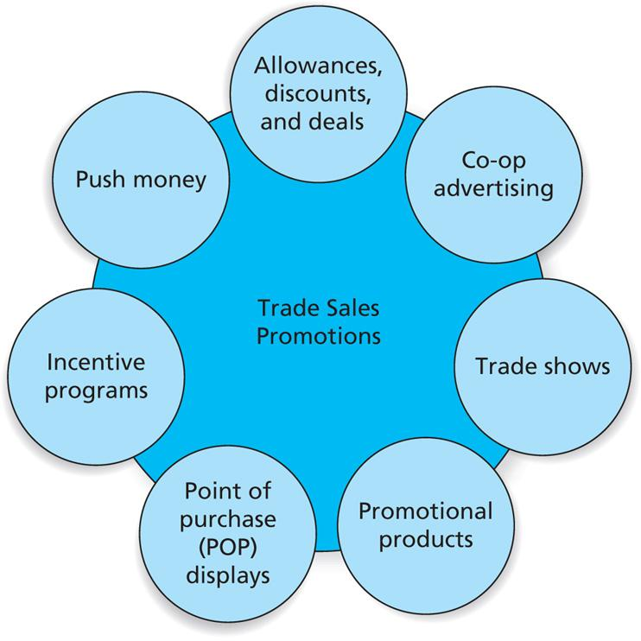
Figure 11.7
Trade Sales Promotions
Copyright © 2013 Pearson Canada Inc.
11-<number>
Notes:
This slide relates to LO #5 of chapter 11.
p. 420

Slide 43
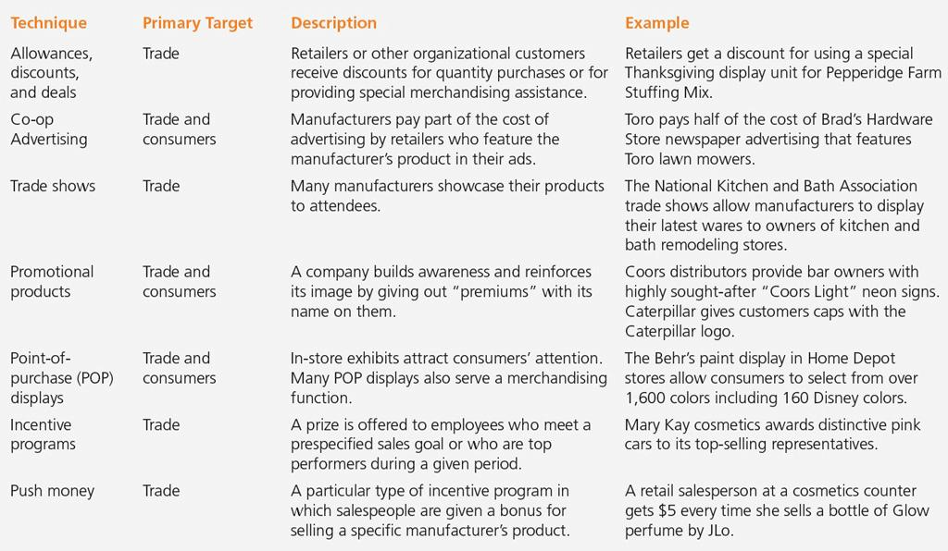
Table 11.5
Characteristics of Trade Sales Promotion Approaches
Copyright © 2013 Pearson Canada Inc.
11-<number>
Notes:
This slide relates to LO #5 of chapter 11.
p. 421
LECTURE NOTES:
Several trade promotions shown in Table 11.5 are designed to increase industry visibility:
Trade shows are industry events held in large convention centers where vendors, suppliers, manufacturers from a given industry get together to share information about new products, generate sales leads, and make contacts. Only those who work in an industry can attend – these are not the same as the consumer product shows that you might have attended at the local convention center.
Promotional products include branded items such mugs, clocks, mouse pads, polo shirts, pens and the like that list the name and logo of an organization. Members of the sales force often use promotional products as favors that are given to prospects or existing clients to build awareness or create good will.
Point-of-purchase (POP) displays include temporary, semi-permanent, and permanent displays, as well as in signs, banners, floor ads, plastic reproductions of products, shopping cart ads and in-store television. POP displays offer a variety of benefits, including increasing consumer awareness of products, increasing impulse buys, reinforcing mass advertising and increasing off-shelf merchandising space. Retailers are generally overwhelmed with POP displays; manufacturers typically find that a merchandise allowance is helpful in convincing retailers to use displays.
Incentive programs are often aimed at the firm’s own sales force. Push money is often used to motivate the sales force to sell older models, unpopular colors, or just to sell more product or demonstrate a certain item. Push money may take the form of cash bonuses, trips, or prizes.

Slide 44
BAB235 In class
Activity
As a marketing consultant, you are frequently asked by clients to develop recommendations for marketing communication strategies.
The elements used include advertising, sales promotion, public relations, personal selling and direct marketing.
Which of these do you feel would be most effective for each of the following clients?
a. A company that provides cellular phone service
b. A hotel
c. A university
d. A new soft drink
e. A sports equipment company
Explain your answer.
Copyright © 2013 Pearson Canada Inc.
13-<number>

Slide 45
VI. Understand the elements of direct marketing
Copyright © 2013 Pearson Canada Inc.
11-<number>
Notes:
This slide relates to LO #6 of chapter 11.

Slide 46
Direct Marketing
Direct marketing
    Any direct communication to a consumer or business recipient designed to generate a response in the form of an order, a request for further information, and/or a visit to a store or other place of business for purchase of a product
Copyright © 2013 Pearson Canada Inc.
11-<number>
Notes:
This slide relates to LO #6 of chapter 11.
p. 423

Slide 47
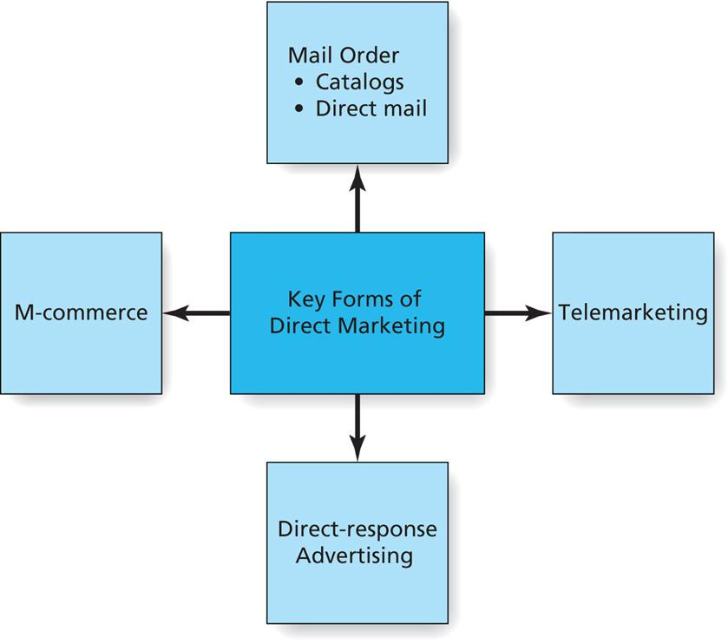
Figure 11.8
Key Forms of Direct Marketing
Copyright © 2013 Pearson Canada Inc.
11-<number>
Notes:
This slide relates to LO #6 of chapter 11.
p. 423
LECTURE NOTES:
The four key forms of direct marketing are shown in Figure 11.8. Each is explained in more detail on the following slides.

Slide 48
Mail Order
Comes in two forms
Catalogs
    Collection of products offered for sale in book form, usually consisting of product descriptions accompanied by photos of the item
Direct Mail
    A brochure or pamphlet that offers a specific good or service at one point in time
Copyright © 2013 Pearson Canada Inc.
11-<number>
Notes:
This slide relates to LO #6 of chapter 11.
p. 423 - 425

Slide 49
Telemarketing, Direct-Response Advertising, and M-Commerce
Telemarketing
    Direct marketing conducted over the telephone
Direct-response advertising
    Allows consumer to respond by immediately contacting the provider with questions or an order
  Direct-response TV (DRTV)
  Infomercials
M-Commerce
    Promotional and other e-commerce activities transmitted over mobile phones/devices
  Short-messaging system (SMS) marketing
Copyright © 2013 Pearson Canada Inc.
11-<number>
Notes:
This slide relates to LO #6 of chapter 11.
p. 425 - 427

Slide 50
VII. Understand the important role of personal selling and how it fits into the promotion mix
Copyright © 2013 Pearson Canada Inc.
11-<number>
Notes:
This slide relates to LO #7 of chapter 11.

Slide 51
Personal Selling: Adding the Personal Touch to the Promotion Mix
Personal selling
    Occurs when a company representative interacts directly with a prospect or customer to communicate about a good or service
  The personal touch can carry a long way
  “The more complex, technical, and intangible the product, the more heavily firms tend to rely on personal selling to promote it”
Copyright © 2013 Pearson Canada Inc.
11-<number>
Notes:
This slide relates to LO #7 of chapter 11.
p. 428
LECTURE NOTES:
On a cost-per-contact basis, personal selling is the most expensive form of marketing communication. However, the “Personal touch” aspect of the one-on-one communication is essential for developing relationships between businesses. Plus salespeople provide information back to the firm regarding what customers think, what competitors are doing, and what concerns clients might have.
Personal selling is highly effective for products that are technically complex or too expensive to market via mass media or by other methods. Intangible products are also more likely to be promoted via personal selling.
Selling is one of the major career paths that many students take following graduation. Sales jobs provide high mobility – many CEOs began their company career in sales. Let’s visit the occupational outlook handbook and take a look at current predictions for growth in jobs for sales representatives in the wholesale and manufacturing industries.

Slide 52
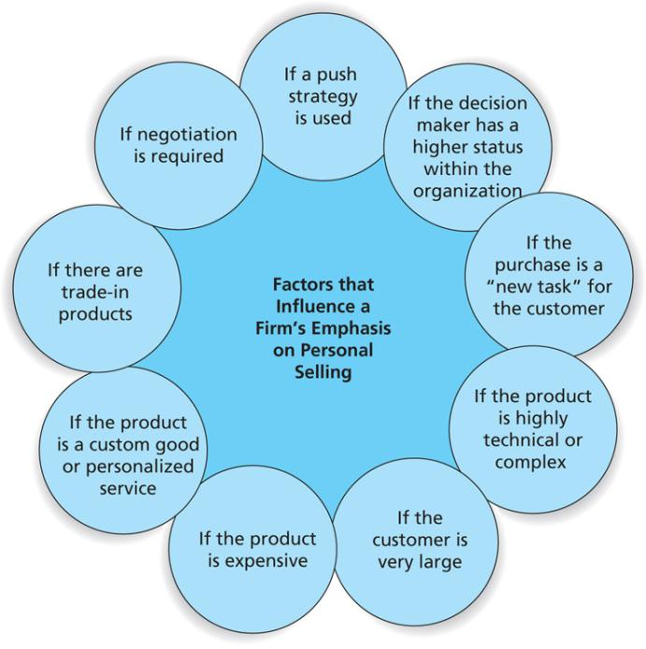
Figure 11.9
Factors That Influence a Firm’s Emphasis on Personal Selling
Copyright © 2013 Pearson Canada Inc.
11-<number>
Notes:
This slide relates to LO #7 of chapter 11.
p. 429
LECTURE NOTES:
Personal selling is often essential if firms seek to land a commitment of some type, such as a contract or purchase. But what’s it’s role in the overall promotional mix? Figure 11.9 lists the various factors that make personal selling more or less important in the promotional mix compared to advertising, and other elements.
Obviously, a strong focus on personal selling is needed when a firm engages in a push strategy, because this strategy dictates that sales and trade promotions be targeted at wholesalers, retailers or other members of the distribution channel. Some advertising may still be used of course, but the push strategy expects the retailer to bear the brunt of efforts meant to reach the ultimate consumer.
Personal selling is also critical when the selling firm interacts with upper level management of the client firm, and certainly when negotiations are required concerning price, trade-ins, or the need for customized or personalized services.
Personal selling is also extremely helpful when the buying firm is undertaking a “new task” purchase for a product or service with which they have no experience. As mentioned earlier, the more complex or technical a product, the more likely it is that personal selling will be necessary to explain the benefits to the client, as well as how the product works.
Because personal selling is expensive, it tends to restricted to larger customers for whom the high dollar sales volume will justify the time and expense associated with personal selling.

Slide 53
Technology and Personal Selling
Numerous technologies help enhance the selling effort
  Specialized software
    Customer relationship management software, account management software, partner relationship management software
  Teleconferencing, videoconferencing, and improved corporate Web sites
  Voice-over Internet protocol (VoIP)
Salesforce.com
Copyright © 2013 Pearson Canada Inc.
11-<number>
Notes:
This slide relates to LO #7 of chapter 11.
p. 430 – 432
LECTURE NOTES:
Many technologies can enhance the personal selling process. Smart phones provide easy and instant access to information that clients need to know, as well as offering an excellent communication channel. Although the internet access to email and website information is convenient, it can’t replace the face-to-face contact necessary when high-dollar sales are on the line, which is why smart phones are simply a tool used as part of the overall selling process. Laptops, various types of software, VoIP, wireless, teleconferencing, videoconferencing, and corporate web sites are also helpful tools.
Customer relationship management (CRM) and account management software such as Goldmine and ACT have helped salespeople manage their client information and prospect databases. Relatively inexpensive, these programs are easy to use and offer salespeople drop down menus, customizable information fields, and easy report generation features, all of which help the sales rep to be more productive and save valuable time.
Cloud computing applications are more customizable and integrative than either ACT or Goldmine. Salesforce.com offers one of the leading applications in the industry. Cloud platforms have the advantage of low monthly costs, as clients rent the CRM system on a monthly basis, rather than paying major capital outlays to own advanced CRM software systems.
Some firms use partner relationship management to link information between the selling and buying firm. This requires that both supplier and buyers share access to at least some of their data via Intranets or systems that allow each firm to maximize the usefulness of the data.
Teleconferencing and videoconferencing offer excellent methods of bringing together interested parties from different locations at minimal costs, and corporate websites often offer customers the opportunity to self-serve via FAQs or access to shipment tracking / account management information.
VoIP systems like Skype help salespeople on the road to talk to other Skype users for free, or very inexpensively to regular phone lines. Customers and salespeople alike are also becoming more comfortable with webcam usage and instant message technology.
Finally, many salespeople use video demonstrations via their laptop to demonstrate product usage or other factors that would be difficult to do otherwise.
WEBSITE NOTES:
As of April 2011, all key CRM sites (ACT, Goldmine, Salesforce.com’s Sales Cloud) required individuals to register prior to being allowed to view demos of the software in question. Demos found on YouTube for Goldmine and ACT tended to be too long for class usage (6 – 9 minutes). Therefore, instructors may wish to visit the salesforce.com website prior to class, register, and preview the demo before deciding whether or not to leave the link shown on this slide in the presentation. Click the “View demo” link to begin the registration process.

Slide 54
All rights reserved. No part of this publication may be reproduced, stored in a retrieval system, or transmitted, in any form or by any means, electronic, mechanical, photocopying, recording, or otherwise, without the prior written permission of the publisher. Printed in Canada.
Copyright © 2013 Pearson Canada Inc.

